Slide 1
AQA GCSE Geography
This booklet contains a summary of content on each paper along with links to key revision resources.
Use this information to Guide yourself
Use your topic checklists to check you have covered everything in your revision.

Slide 2
Exam details | Content of paper
Paper 1 Living with the physical environment 22nd May (pm) 1hr 30 mins | Section A – Hazards Tectonic Hazards (case studies Nepal and Japan) Weather hazards (case studies Beast from the East and typhoon Haiyan) Section B – The living world Ecosystems (pond is small scale example) Tropical Rainforests (Malaysia) Hot deserts (Thar desert) NOT cold environments Section C – UK Landscapes Rivers (River Tees, Wansbeck (Morpeth) flooding Coasts (Northumberland coast – Blyth, Seaton Sluice) NOT glaciation
Paper 2 Challenges in the human environment 9th June (am) 1hr 30mins | Section A – Urban issues and challenges The Urban world (Lagos case study) Urban Change in the UK (Newcastle case study) Sustainable Urban Development Section B – The Changing Economic World The development gap (causes, effects and solutions - Jamacia case study in this) Nigeria – a NEE (Nigeria case study) The Changing UK economy Section C – The challenge of resource management Resource management (global distribution, then provision of food, water and energy in UK) Energy Management – global scale (Including Chambamontera micro-hydro case study) NOT Food management NOT water management
Paper 3 Geographical applications 16th June (pm) 1hr 15mins | Section A – Issue Evaluation Questions based on the pre release (we will not get this document until the end of March) Section B – Fieldwork Questions based on unseen fieldwork Questions based on your fieldwork – Blyth and Seaton Sluice beach and Bedlington Station. Geographical skills – maps, graphs, statistics

Slide 3
NATURAL HAZARDS
TERM | DEFINITION
HIC | High Income Country
LIC | Low Income Country
Constructive margin | When 2 plates move away from each other = volcanoes + earthquakes.
Destructive margin | When 2 plates collide and 1 subducts = volcanoes and earthquakes.
Conservative margin | When 2 plates move past each other = only earthquakes.
Tectonic hazards | Volcanoes and earthquakes.
Primary Effect | Something that occurs as a direct result of the hazard. EG. Water pipes burst.
Secondary Effect | Something that occurs because of a primary effect. EG. No clean water.
Immediate response | Something that is done straight away to try and save lives.
Long-term response | Something done later on to rebuild and get back to normal.
Low pressure | When warm air rises to form clouds.
Storm surge | Sea water is blown onto the land by a tropical storm.
Extreme weather | Weather that is significantly worse than normal.
3 P’s | Predication, Planning and Preparation.
Climate change | Changing weather around the world.
Mitigation | Stopping the causes of climate change.
Adaption | Living with the effects of climate change.
Management | Minimise or stop effects from a hazard.
Paper 1 – Physical Geography – KEY TERMINOLOGY
PHYSICAL UK LANDSCAPES
TERM | DEFINITION
Erosion | When rock is worn away and broken.
Transportation | When rocks are moved by water.
Deposition | When water loses energy and drop material is carrying.
Landforms | Features of the coastline.
Erosional landforms | Features created because of erosion: RIVER: Waterfall & gorge / meander / oxbow lake / floodplain. COAST: wave cut notch & platform / headland & bay / cave, arch, stack, stump
Depositional landforms | Features created because of deposition: RIVER: levees / floodplain / estuary / delta COAST: beach / sand dunes /spit / bar / salt marsh
Weathering | When rock is weakened but not moved.
Mass Movement | When rock breaks off a cliff face. Can be a slump or a slide.
Flashy hydrograph | Short lag time / high discharge – water has got to the river quickly (surface run off)
Subdued hydrograph | Long lag time / low discharge – water has got to the river slowly (throughflow).
Flooding | Water overflows onto the land.
Physical causes | Causes rooted in nature (EG. Heavy rain)
Human causes | Caused by humans (EG. Deforestation)
Management | Minimise or stop the effects of a hazard.
Hard Engineering | Building structures to stop the river flooding. EG. Flood walls.
Soft Engineering | Using natural processes or minimising effects. EG. Planting trees
THE LIVING WORLD
TERM | DEFINITION
Ecosystem | A natural place made of living and non-living things.
Biome | An ecosystem on a large scale.
Producers | Organisms that can convert energy from the sun.
Consumers | Organisms that eat producers or animals.
Decomposer | Bacteria that breaks down dead plants and animals to return nutrients to the soil
Energy | What powers the ecosystem – it comes from the sun and passes through the system.
Nutrients | Stored in the soil, biomass and litter. Provide a source of food.
Local change | Change occurring in a small area.
Global change | Change affecting the whole world.
Characteristics | Main features. EG. Types of plants.
Adaption | The way plants and animals survive.
Biodiversity | Different types of plants and animals.
Deforestation | Cutting the rainforest down.
Sustainable management | Protecting the rainforest but also being able to use it to make money.
Economic Opportunities | Using the desert to make money: tourism, farming, energy and mining.
Challenges | Factors that make it difficult to use the desert: heat, lack of rain and lack of roads.
Development | Using the desert to improve life in a place.
Desertification | When all the nutrients in the soil have been used and nothing can grow.
Human activity | The way humans use the land. EG. Farming, grazing etc.

Slide 4
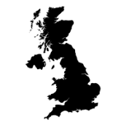
URBAN ISSUES AND CHALLENGES
TERM | DEFINITION
NEE | Newly Emerging Economy.
Urbanisation | Increased amount of people living in cities.
Urban sprawl | The size of the city increasing.
Megacity | City with a population over 10 million.
Opportunities | Positives / advantages (give people a better life).
Challenges | Negatives / disadvantages (makes peoples’ lives worse).
National Importance | Why it is important for the country that it is in.
International importance | Why it is important for other countries and the whole world.
Urban planning strategy | Things done to improve life for people living in the city.
Regeneration | Improving or redeveloping an area to attract people and investment back.
Multiplier Effect | When businesses move in, this attracts people -this repeats increasing the economy.
Inner City | The poorest part outside the city centre.
Rural-urban fringe | Where the city meets the countryside.
Economic Inequality | Gaps in wealth between different parts of the city. Inner city = poor. Suburbs = rich.
Ethnic Segregation | When the same ethnic groups living in the same parts of the city.
Congestion | Traffic.
Urban decline | When the city becomes run down.
Sustainability | Minimising environmental impact and making sure people have jobs and a good life
Paper 2 – Human Geography – KEY TERMINOLOGY
CHANGING ECONOMIC WORLD
TERM | DEFINITION
Development | Measure of the quality of life.
Development gap | The difference in quality of life between different countries.
Development indicators | Factors that show us how good life is in a country. EG. Life expectancy, birth rate etc.
Population structure | The amount of people of certain ages in a population. Shown as a population pyramid.
Migration | When people move from one place to another.
Intermediate technology | Appropriate technology – equipment that is cheap and easy to use.
Fair trade | When farmers receive a fair price for crops.
Aid | When one country sends money or supplies to another.
TNC | Trans-national corporation. Big companies that operate in more than one country EG. Shell
HDI | Human Development Index (scores country between 0 and 1 on their development)
Tertiary sector | Service industry. EG. Teachers, retail etc.
Quaternary sector | Jobs in science, research and technology.
Science parks | High tech industries locate near universities.
Business parks | Businesses locate near each other.
Infrastructure | Transport links – road / rail / air / ports
North south divide | The difference in wealth between the north (poor) and the south (rich).
Wider world connections | UK working with other countries to gain money – EG. EU, The Commonwealth.
RESOURCE SECURITY
TERM | DEFINITION
Resources | Something that has value or purpose.
Finite | Once its used it can’t be used again.
Renewable | Something that can be used again.
Malnourishment | Not have the right balance of food to eat.
Undernourishment | Not having enough food to eat.
Agribusiness | Large scale commercial farming of crops to make profit.
Organic farming | Food farmed without use chemicals.
Energy mix | The range of sources a country gets its energy from. EG. Oil, coal etc.
Water security | Having enough water to meet the needs of the population.
Water stress | When a place does not have enough water.
Water surplus | More water than needed for the people.
Water deficit | More people than water available.
Physical water scarcity | A lack of water from rainfall in an area.
Economic water scarcity | When water is available but a place can’t afford to access / clean it.
Water transfer scheme | When water is moved from one place to another. Through pipe / tanker / river.
Sustainable water | When there is sufficient water to last people now and in the future.
Grey water | Water that has already being used that can be re-used again. EG. From a sink.

Slide 5
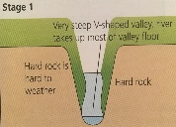
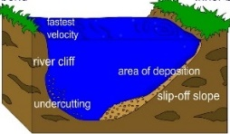
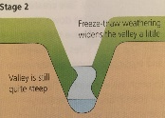
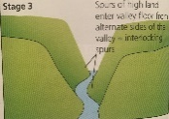
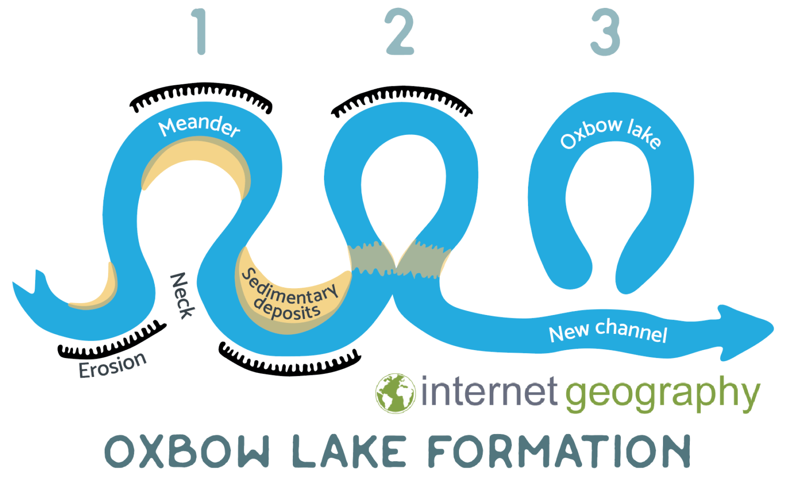
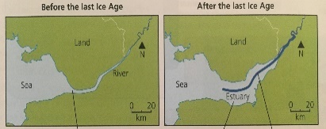
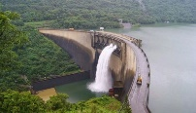
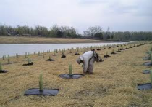
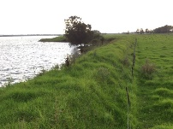
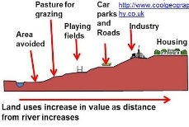
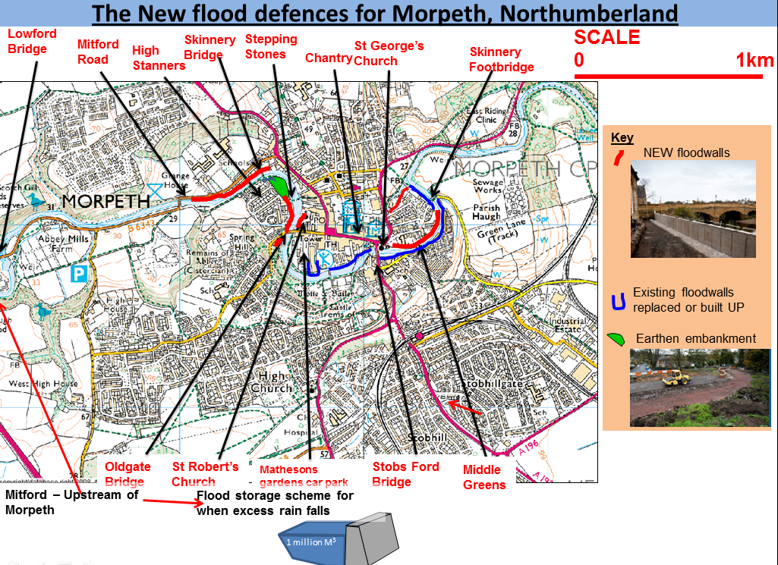
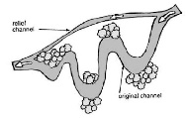
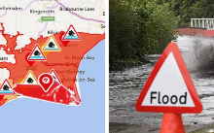
Paper 1: UK Landscapes - Rivers
Erosion –rocks broken down/wear away in the river
Abrasion – rocks rubbing off the river bed /banks
Attrition – rocks bump into each other in the river
Solution – rocks dissolve in river water
Hydraulic Action – water and air forced into cracks
Transportation - movement of the sediment from upper to lower course
Saltation – rocks bounced along the river bed
Suspension – finer sediment floats along the river
Solution – fine (almost invisible) sediment carried along
Traction – large rocks rolled along the river bed
Long River Profile
Cross Profile
The upper course is V shaped due to vertical erosion. The velocity here is slowest due to the rough and uneven river bed. As you move into the middle course
Source
Fluvial
Processes
Mouth
the cross profile becomes wider due to lateral erosion. The velocity has started to increase due to the larger volume of water in the river. In the lower course the cross profile is at its widest and deepest. The relief here is low and the velocity is higher due to the smooth surface of the river bed meaning there is less friction to slow the river down.
Interlocking Spurs
Waterfalls / Gorges
Outside of bend
Meanders / Oxbow lakes
In the upper course of the river there is vertical erosion eroding down to make the valley deeper as the river has more energy.
Weathering on the sides of the valley causes rocks to fall off, land in the river and cause more vertical erosion and abrasion to deepen the river channel.
The river cannot erode the hard rock slopes so will flow around them and erode the softer rock. This leaves interlocking spurs, slopes on the valley that look like they overlap.
In the upper course, the river flows over hard resistant rock and soft less resistant rock. The soft rock is eroded by abrasion and hydraulic action and a small plunge pool forms.
The overhanging hard rock is not supported so falls into the plunge pool.
The rocks in the plunge pool cause more abrasion and the plunge pool gets bigger and the overhand collapses again.
Over time the waterfall retreats to leave behind a steep sided gorge on each side of the waterfall.
inside of bend
Found in the middle course, meanders are a bend in the river. The river will flow until it reaches an obstacle in the river, this causes pools and riffles to form. Pools are the deeper areas of fast flowing water and riffles are the shallower slower flowing
water. This then develops into helicoidal flow (the corkscrew motion of the water in the river). There is more erosion around the outside of the river bend as the river has more energy because it is deeper this undercutting and erosion creates a river cliff. There is deposition on the inside of the bend as the river has less energy as it is shallow and there is more friction resulting in a slip off slope. The meander loop becomes tight because of lateral erosion. The river floods and takes a short cut straight across the meander. This repeats, river makes a new straight channel. The meander is cut off by deposited sediment to leave an oxbow lake.
River
Landforms
Floodplains
Levees
Found in the lower course, levees are naturally raised river banks found on either side of a river channel. During a flood water spills onto the land. This creates friction and the river velocity (speed) slows down meaning the heavier sediment is deposited on
Levees
Estuaries
Found at the end of the rivers journey at the lower course where it meets the sea. After the ice age, sea levels increased and low land
Flooding & management
Found in the lower course, flood plains are large areas of flat land on each side of the river that are flooded. They are made up of layers of sediment that is deposited when the river floods and looses energy; this is due to friction on the land and therefore depositing sediment. After each flood, the floodplain gets higher as sediment is deposited (dropped).
and low land at the river mouth was flooded creating estuaries. Also, when the seas tide comes in and meets the river water the river looses it’s energy and deposits the last pieces of find sediment it is carrying making mudflats.
the edge of the river channel. Flooding repeats and there is more deposition so the sediment on the side builds up to form a levee.
Hydrographs and Flooding
Hard Engineering
Soft engineering
Flood Management Example – River Wansbeck Morpeth
Location: Morpeth is an ancient market town situated in a loop of the river Wansbeck in the northeast of England about 15 miles north of Newcastle upon Tyne and 12 miles west from the North Sea.
The problem? Increasing urbanisation, a steep, narrow valley along with many natural events in 2008 including saturated soil and prolonged rainfall led to significant flooding with substantial damage to homes and businesses.
What did they do? Spent £27million on building a flood defences for the town along with developing a dam system upstream to limit the water flow into river in times of peak discharge
Hydrographs show how the level of water in the river changes after it has rained. This hydrograph has a steep rising limb meaning the water went back to the river very quickly.
Physical Causes
1. heavy precipitation (rain) means the water can not be infiltrated (absorbed into the ground) quickly as the ground is saturated. There is more surface run off as the water goes to the river.
Dams – giant wall across the river to stop / control the river flow
Hydro electric power from the lake behind
Expensive at £1 billion!
Levees – man made raised river banks so the river can hold more water
Look more natural if they are covered in grass
Water can rise higher than the level and still cause flooding
Flood relief channel– a separate river is made so that water can be split between the two rivers and then meet up again
Creates new habitats around the new river
Increases flooding down river when they meet up again
Afforestation- planting trees to absorb and soak up the rain water
Creates new habitats
Takes up a lot of land and is not good in urban areas
Flood plain zoning – land is organised so that areas near the river that are at risk are not built on
Keeps green spaces in urban areas
Many cities have already been built near the river and this cannot be changed
Flood warning – warning people that a flood is going to happen so people can prepare
cheaper as people can save their belongings
The flood still occurs and damages the buildings which costs money
Advantages?
Protects the town and homes, created areas for wildlife overall reducing flood risk
Disadvantages?
Increased risk of flooding
Elsewhere
Costs
Visual impact of walls
Urbanisation continues
2. Geology (hard impermeable rock) means the water can not be infiltrated (absorbed into the ground) as there is no space for the water. There is more surface run off as the water goes to the river.
Human Causes
1. urbanisation (building cities) concrete and tarmac are impermeable so there is more surface run off and water returns to the river
2. Deforestation – trees are removed so there is less interception (water caught and stored by the trees). There is more surface run off and the water goes to the river.

Slide 6
The Final Countdown – GCSE Geography Resources – Students will be given these as they are released in chunks. QR code takes them to resources with that focus each week.
www.internetgeography.net/tfc
Paper 1 – 22/05/21 | Paper 2 – 09/06/21 | Paper 3 – 16/06/21
Week | Visit | Revise | Quiz | Exam Question(s)
1 23/01/23 |  | Ecosystems TRF
2 30/01/23 |  | Hot Deserts | Ecosystems TRF | Using Figure 1 and your own knowledge explain how plants have adapted to the physical conditions of the tropical rainforest. (6) Some economic activities in tropical rainforests have major environmental impacts. To what extent to do you agree? Use Figure 2 and a case study to explain your answer. (9)
3 06/02/23 |  | Hazards Tectonic Hazards | Hot Deserts | Using Figure 3 and your own knowledge explain how animals have adapted to survive in a hostile environment you have studied. (6) Using a case study, to what extent have opportunities for economic activity had a negative impact on the natural environment. (9)
4 13/02/23 |  | Weather Hazards Climate Change | Hazards Tectonic Hazards | Using Figure 4 and your own understanding, suggest how plate movements causes tectonic hazards along destructive plate margins (6) Immediate responses to a tectonic hazard are more important than long-term responses. Do you agree? Using Figure 5 and one or more examples, explain your answer. (9 +3).
5 20/02/23 |  | River Landscapes in the UK | Weather Hazards Climate Change | Explain how burning fossil fuels and deforestation may have contributed to global changes in temperature. (4) Suggest how extreme weather in the UK can have economic and social impacts. Use Figure 6 and your own understanding. (6) Managing climate involves both mitigation and adaptation. Do you agree? Explain your answer. Use Figure 7 and your understanding. (9 +3) Assess the extent to which tropical storms have effects on people and the environment. Use Figure 8 and an example you have studied. (9 +3).
6 27/02/23 |  | Coasts | River Landscapes in the UK | Explain how oxbow lakes are formed. (4) Explain how hard engineering strategies can help reduce the impact of river flooding. Use Figure 9 and your own understanding. (4) Explain how physical and human factors may affect flood risk. Use Figure 9 and your own understanding. (6)

Slide 7
Exam paper practice can be found here https://www.aqa.org.uk/subjects/geography/gcse/geography-8035/assessment-resources?f.Resource+type%7C6=Question+papers Additional revision materials are available to purchase from school – Revision cards £4.15 Revision Guide £2.60 Revision Workbooks £2.60 Revision materials for case studies have been given in class, Countdown from week 7 will be shared once the linked resources for those weeks have been released on the internet Geography website. Seneca also has a wealth of revision practice – students are part of a class with teachers – if they need the code again they must see their own class teacher. Geography revision drop in on a Monday lunchtime in F24. Structured intervention/revision on a Monday lunchtime in F25 Independent revision – room availability Tuesday/Wednesday lunchtime in F25 (Let Miss Churnside know in advance) Intervention – Friday 3.15-4 in F26

